Slide 1
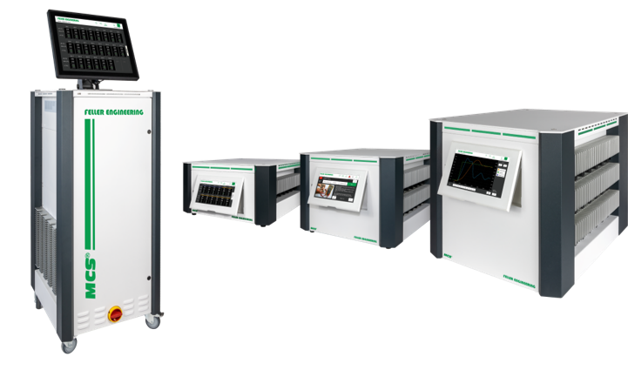
MCS®
Hot runner controller
Uncompromisingly
simple and intuitive
The controllers that leave nothing to be desired.

Slide 2
1
High quality design
Durable and reliable
2
New benchmark in ease of use
Operation without instructions and without training
3
Comprehensive functionality
Everything you need inside
The controllers that leave nothing to be desired.

Slide 3
1
High quality design
Durable and reliable
2
New benchmark in ease of use
Operation without instructions and without training
3
Comprehensive functionality
Everything you need inside
The controllers that leave nothing to be desired.

Slide 4
1
High quality design
Durable and reliable
2
New benchmark in ease of use
Operation without instructions and without training
3
Comprehensive functionality
Everything you need inside
The controllers that leave nothing to be desired.

Slide 5
1
High quality design
Durable and reliable
The controllers that leave nothing to be desired.

Slide 6



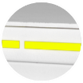

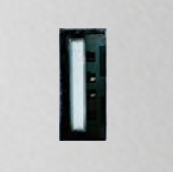

LED strip
LED stripe
Operating status visible from a distance
Normal operation
Non-critical deviations
Critical deviations = alarms

Slide 7
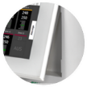
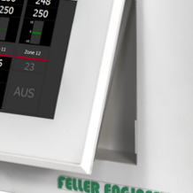
LED strip
Tiltable display
Tiltable display
Very easy to read from any angle

Slide 8


LED strip
Tiltable display
Heat sinks outside
External heat sink
Heat dissipation ensures longer service life of the electronics

Slide 9
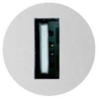
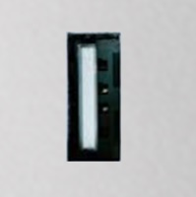

LED strip
Tiltable display
Heat sinks outside
USB
USB port
Easy installation of updates
Transfer of files such as test protocols or recipes

Slide 10

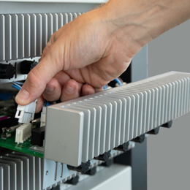
LED strip
Tiltable display
Heat sinks outside
USB
Service friendly
Service friendly
Fuses and power cards can be replaced without opening the device.

Slide 11
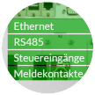
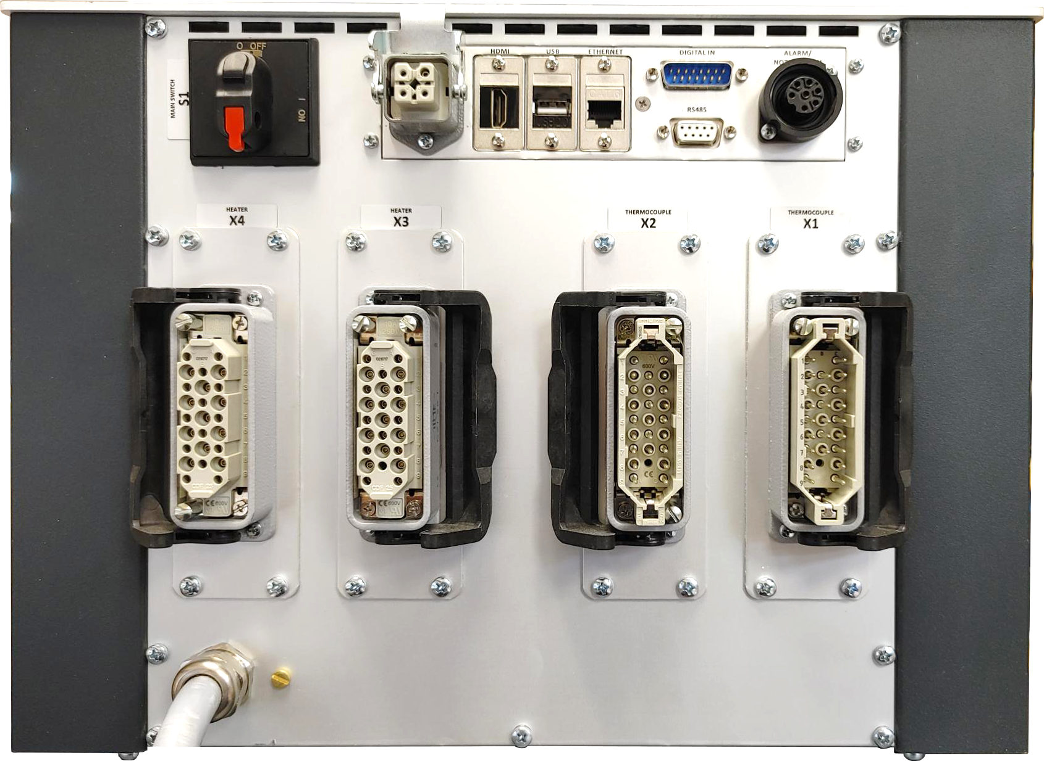
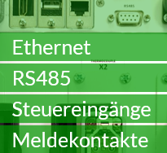
LED strip
Tiltable display
Heat sinks outside
USB
Simple
Service
Data interfaces
Machine connection
Flexible connection to the machine
OPC UA based on Euromap 82.2 is fully integrated.

Slide 12
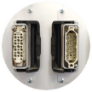
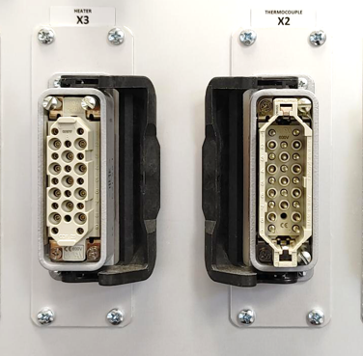
LED strip
Tiltable display
Heat sinks outside
USB
Simple
Service
Data interfaces
Flexible
Connections
Flexible connections to the mold
Plug-in system and assignment according to customer requirements at no extra cost

Slide 13
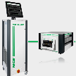
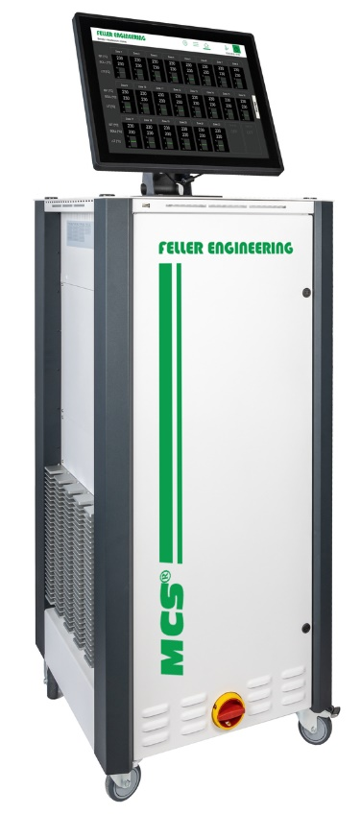
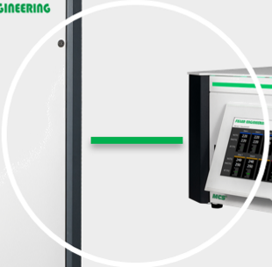
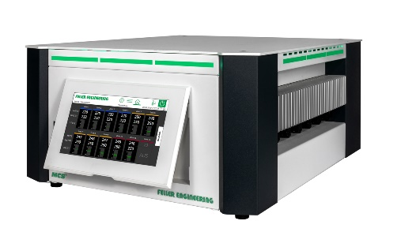
LED strip
Tiltable display
Heat sinks outside
USB
Simple
Service
Data interfaces
Flexible
Connections
Device network
Device network
Connect devices via network and operate up to 480 zones centrally

Slide 14
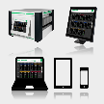
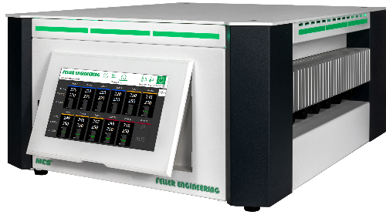
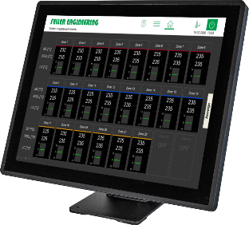

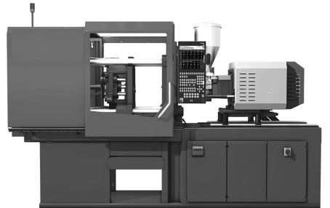

LED strip
Tiltable display
Heat sinks outside
USB
Simple
Service
Data interfaces
Flexible
Connections
Device network
4-fold
Operation
4-fold operation
Integrated touch display
15" / 19" touch monitor
Injection molding machine
Notebook / Tablet / Smartphone
VNC

Slide 15



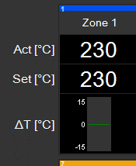
LED strip
Tiltable display
Heat sinks outside
USB
Simple
Service
Data interfaces
Flexible
Connections
Device network
4-fold
Operation
Precise control
Fast and precise control
Expert knowledge from over 40 years of experience
100,000-fold in use worldwide
For all injection weights
For all hot runners

Slide 16

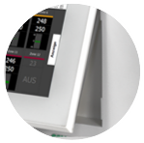

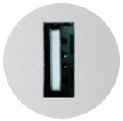
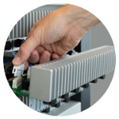

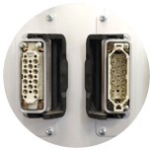
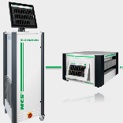
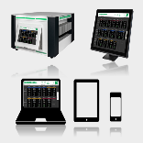

1
Summary
High quality design
Durable and reliable
LED strip
Tiltable display
Heat sink outside
USB
Simple
service
Data interfaces
Flexible
connections
Device network
4-fold
operation
Precise control

Slide 17
1
High quality structure
Long service life and high operational reliability
2
New benchmark in ease of use
Operation without instructions and without training
3
Comprehensive functionality
Everything in it that they need
The controllers that leave nothing to be desired.

Slide 18
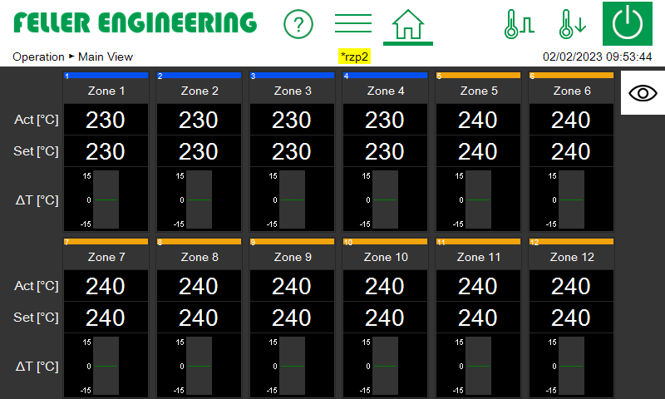
2
New benchmark in ease of use
Operation without instructions
and without training

Slide 19

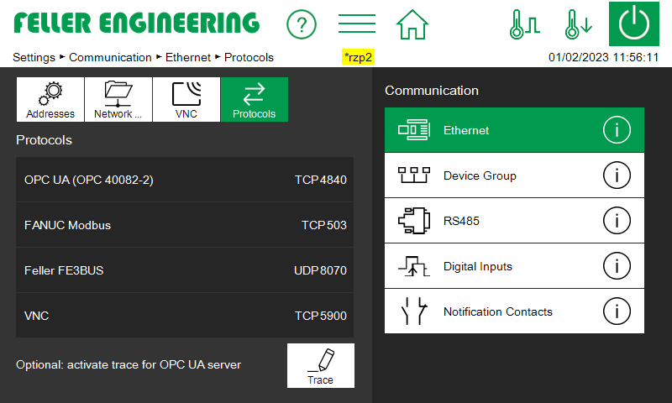
Intuitive
Design
Intuitive design
Always clear where to click
Always visible toolbar
White buttons to click
Green is selected
Icons + text

Slide 20

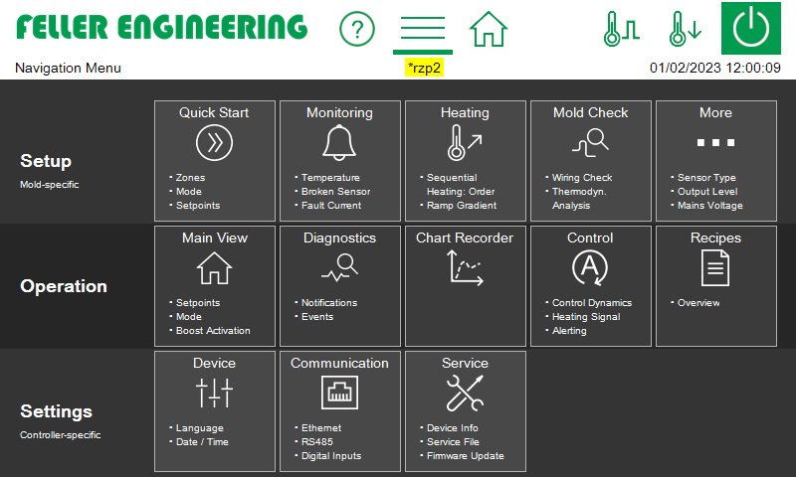
Intuitive
Design
Smart navigation
Smart navigation
Menu bar always visible
All functions at a glance

Slide 21

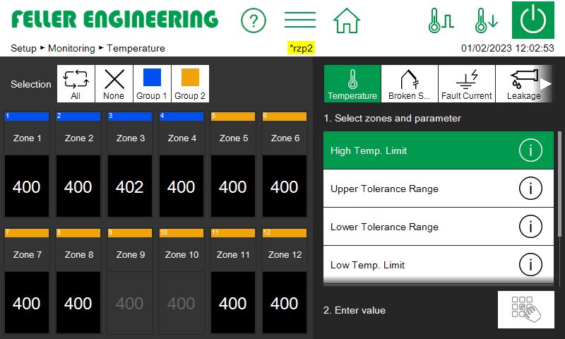

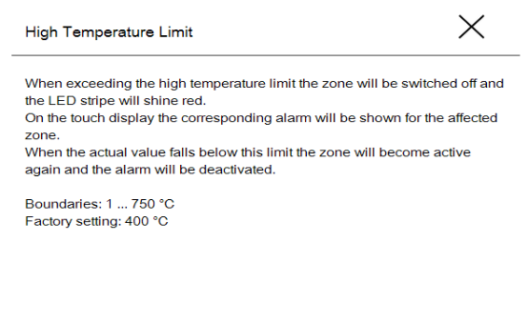
Intuitive
Design
Smart navigation
 Buttons
 Buttons
Description of individual functions at the touch of a button

Slide 22
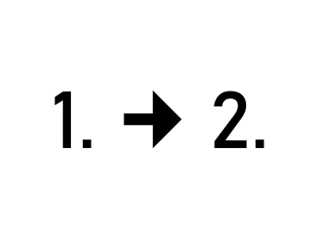

Intuitive
Design
Smart navigation
 Buttons
Guided operation
Guided operation
The controller tells you what to do 1.  2.

Slide 23

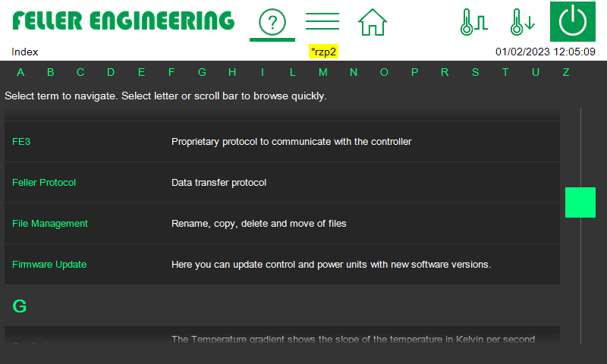
Intuitive
Design
Smart navigation
 Buttons
Guided operation
Index
Index
List of all functions with link to input

Slide 24

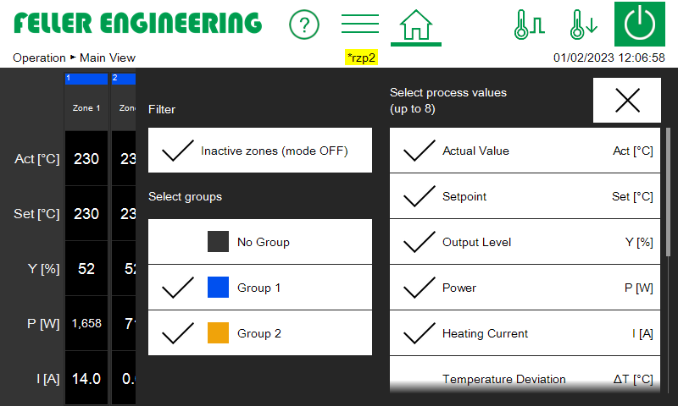
Intuitive
Design
Smart navigation
 Buttons
Guided operation
Index
Individual
Zone display
Individual zone display
Selectable process values
Selectable groups

Slide 25

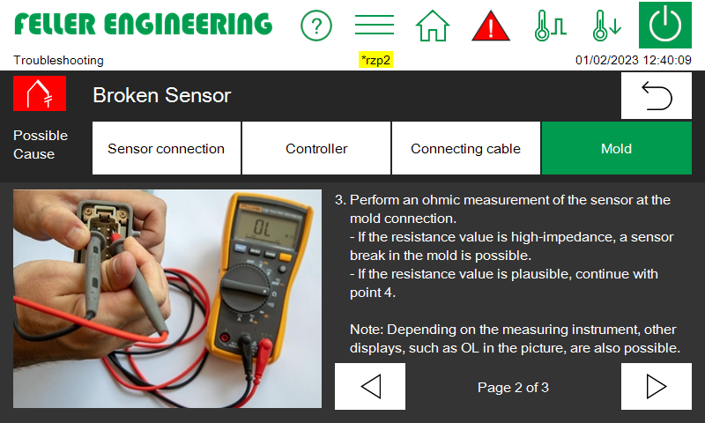
Intuitive
Design
Smart navigation
 Buttons
Guided operation
Index
Individual
Zone display
Service &
Support
Integrated Service & Support
Troubleshooting with illustrated step-by-step instructions

Slide 26

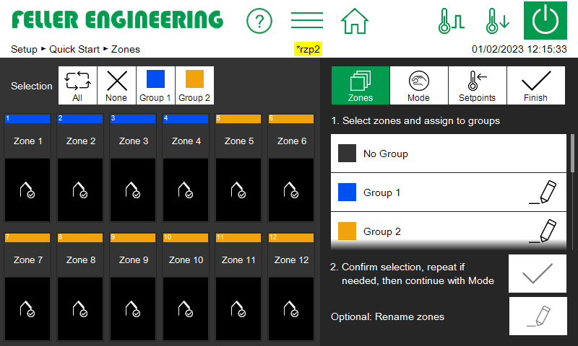




Intuitive
design
Smart navigation
 Buttons
Guided operation
Index
Individual
zone display
Service &
Support
Quick-start
Quick start
Guided setup during tool change

Slide 27





2
Summary
New benchmark in ease of use
Operation without instructions
and without training
Intuitive
Design
Smart navigation
 Buttons
Guided operation
LED tape
Swivel display
Heat sink outside
USB
Simple
Service
Intersections
Flexible
Connections
Device-
association
4-fold
Operation
Precise regulation
Index
Individual
zone display
Service &
Support
Quick start

Slide 28
3
Comprehensive functionality
Everything you need inside.
The controllers that leave nothing to be desired.

Slide 29

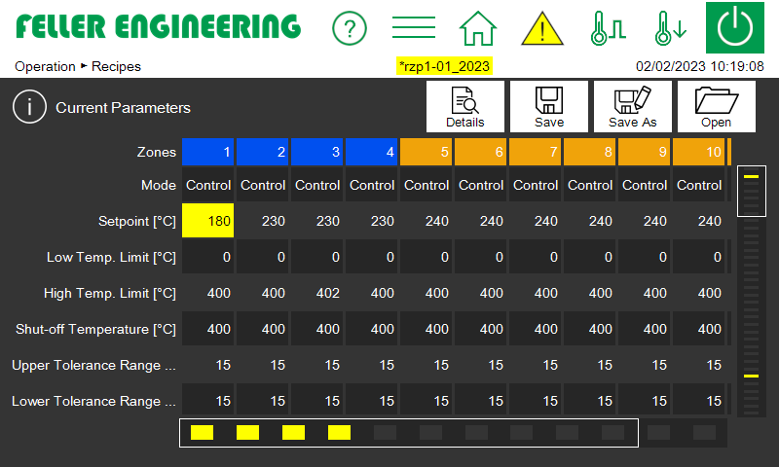
Recipe
management
Recipe management
Store
Save
Compare (yellow = change)

Slide 30
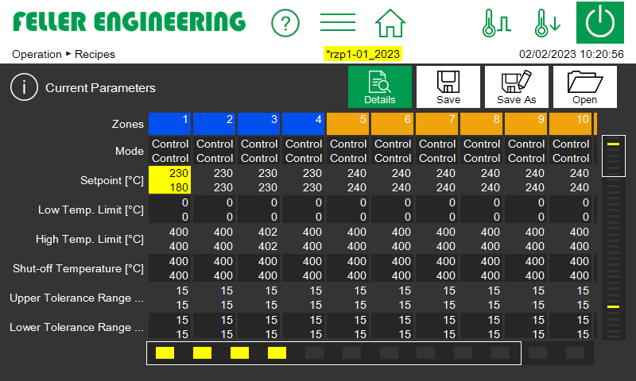
Recipe-
management
Recipe management
Comparison view
Top: value of the recipe Below: current value

Slide 31

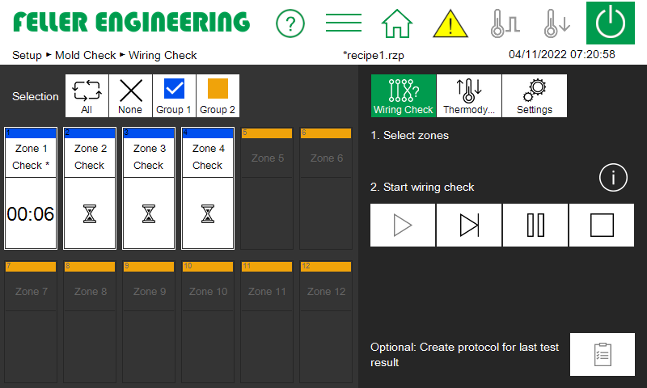
Recipe-
management
Mold check
Mold Check
Wiring test
With HTML protocol

Slide 32

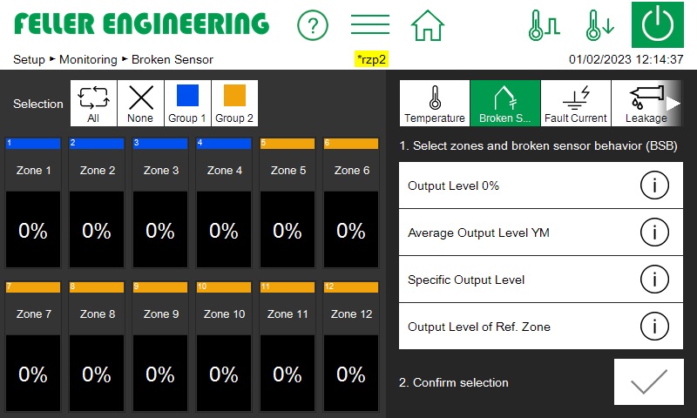
Recipe-
management
Mold check
Continue heating
Sensor break
Continue heating in case of sensor break
4 Behavior in case of sensor break per zone:
Output ratio 0%
Medium output level
Defined output level
Degree of operation of the reference zone

Slide 33

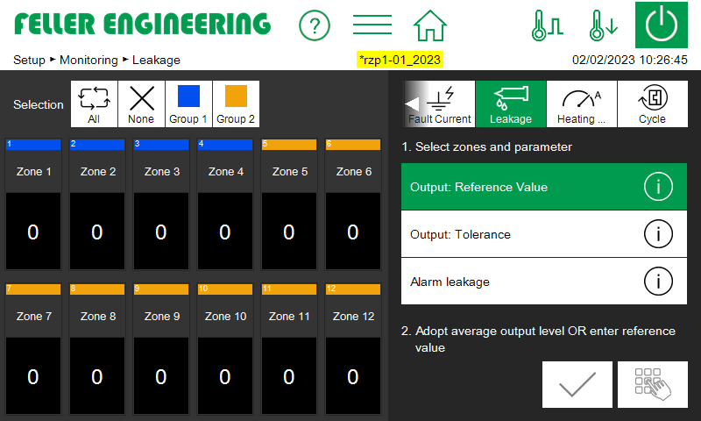
Recipe-
management
Mold check
Continue heating
Sensor break
Leakage
detection
Leakage detection
Detect irregularities in the heating power

Slide 34

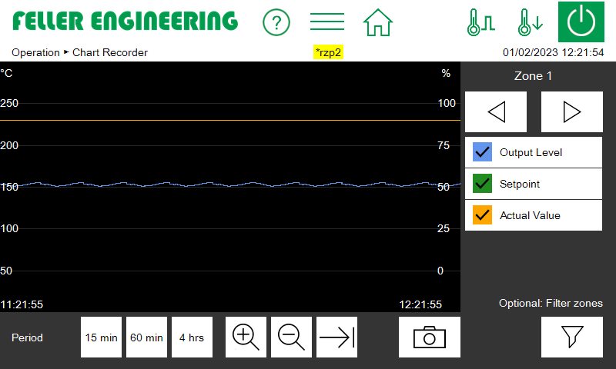
Recipe-
management
Mold check
Continue heating
Sensor break
Leakage
detection
Chart recorder
Chart recorder
Analysis of the heating behavior of zones

Slide 35

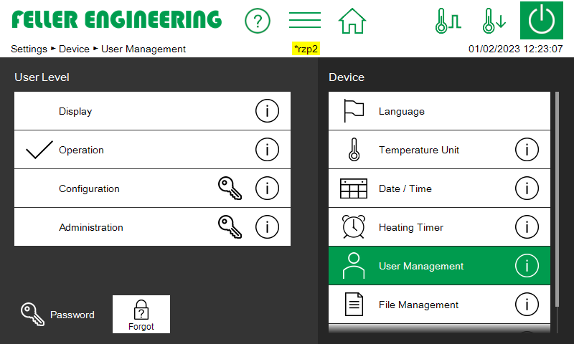
Recipe-
management
Mold check
Continue heating
Sensor break
Leakage
detection
Chart recorder
User
levels
User levels with password protection
Protection against unauthorized changes

Slide 36

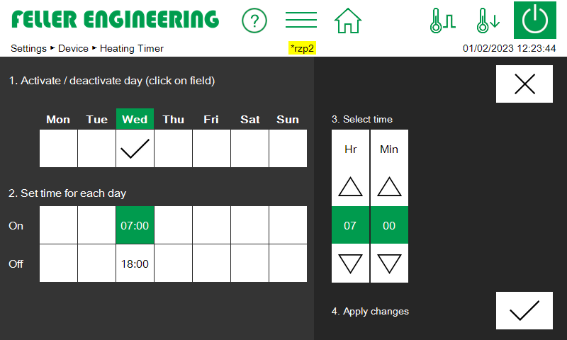
Recipe-
management
Mold check
Continue heating
Sensor break
Leakage
detection
Chart recorder
User
levels
Timer
Timer
Switch controller on / off automatically at specific times

Slide 37

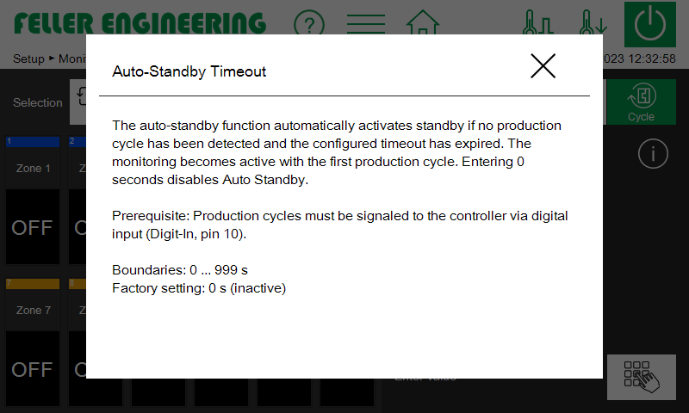

Recipe-
management
Mold check
Continue heating
Sensor break
Leakage
detection
Chart recorder
User
levels
Timer
Auto standby
Cycle monitoring with Auto Standby
Production cycle monitoring with standby activation in case production stops for a predefined time.

Slide 38

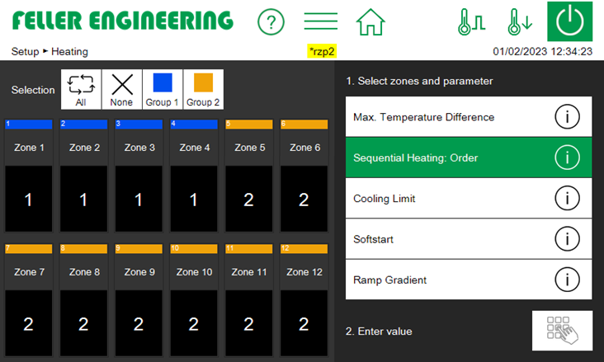
Recipe-
management
Mold check
Continue heating
Sensor break
Leakage
detection
Chart recorder
User
levels
Timer
Auto standby
Sequential
heating
Sequential heating
Heating in a specific sequence
Sequence #1
Sequence #2

Slide 39
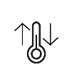
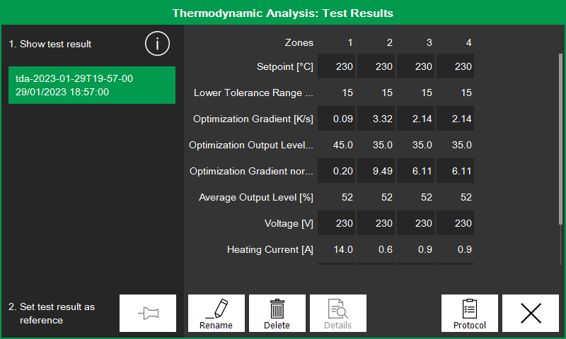

Recipe-
management
Mold check
Continue heating
Sensor break
Leakage
detection
Chart recorder
User
levels
Timer
Auto standby
Sequential
heating
Thermodyn.
analysis
Analysis result
Thermodynamic analysis
Detect anomalies during heating
Comparison of two analyses
Yellow = Heating behavior of the mold has changed

Slide 40









3
Summary
Comprehensive functionality
Everything you need inside.
Recipe-
management
Thermodyn. Analysis
Mold Check
Cont. heating
Sensor break
Leakage-
detection
Chart recorder
User-
planes
Time switch
Auto Standby
Sequential
Heating
... and more

